Slide 1
Infrastructure Trial
Test Coordinators and Test Administrators
Notes:
These training slides give an overview of the steps to prepare for the Infrastructure Trial. It is recommended these slides be used in conjunction with the Infrastructure Trial Readiness Guide.

Slide 2
How to use this PowerPoint
Additional information is included in the Notes section of most slides.
Some slides in this PowerPoint have videos. When this occurs, it will be mentioned in the Notes section.
When a video is available, please hover your cursor over the slide and select the Play button to view the video.
For slides with videos, please remember to read the Notes section for additional information.

Slide 3
Topics
Glossary
Determine Whether to Run an Infrastructure Trial
App Check
Preliminary System Test
Introduction to Infrastructure Trials
Infrastructure Trial Goals
Test Coordinator and Test Administrator Roles
Schedule and Staffing
Capacity Planning
PearsonAccess^{next} Tasks
PearsonAccess^{next} Setup
During and After Trial
Tools and Accessibility Features in TestNav
TestNav Tools Demonstration
Resources
Notes:
In these slides, we will demonstrate the steps to prepare for and administer an Infrastructure Trial. We will cover the roles of test coordinators and test administrators, scheduling the trial and the staff who may need to be involved, planning for device capacity, and PearsonAccess Next (PAN) setup. We will also provide a demonstration of the TestNav tools.

Slide 4
Glossary
Infrastructure Trial: An opportunity for districts and schools to prepare for the computer-based tests by ensuring student devices are set up correctly and simulating test day network use.
PearsonAccess^{next} (PAN): The online management system used by principals, test coordinators, technology coordinators, and test administrators to register students, order test materials, and manage activities for computer-based testing.
ProctorCache: Optional software that precaches (i.e., loads) test content onto a designated machine in the school. In schools with lower bandwidth, ProctorCache can reduce test delays and can provide students with a more seamless testing experience in the event of disruptions to Internet connectivity.
Precache: The process of loading or “caching” test content locally to a designated ProctorCache computer at a school.
TestNav: The online testing platform used by students to take the computer-based MCAS tests.
App Check: A test run in TestNav by school staff to check connectivity to Pearson servers, the ability of the device to enter “kiosk” mode, and the TestNav configuration (if a configuration identifier is used).
Preliminary System Test: A small-scale Infrastructure Trial during which school staff log in to and click through practice tests instead of students.

Slide 5
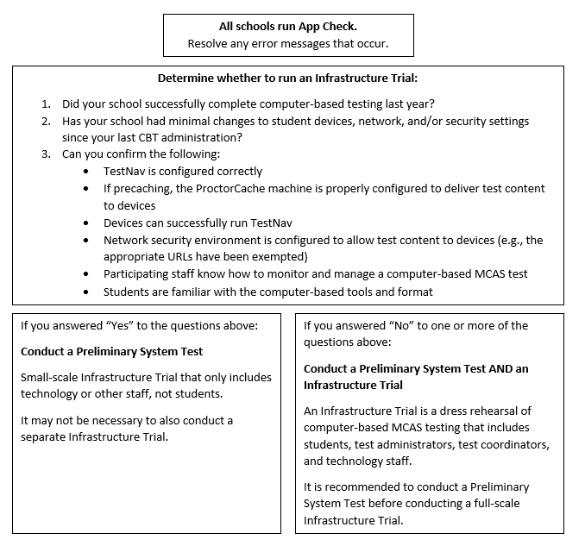
Determine Whether to Run an Infrastructure Trial
Notes:
App Check is completed in TestNav after configuring the network and downloading TestNav on student devices. It confirms that the device can connect to TestNav and that it is able to launch TestNav in kiosk (locked-down) mode. Steps to complete App Check can be found beginning on page 8 of the Infrastructure Trial Readiness Guide, under “Test the “lock down” settings.”

Slide 6
App Check
As a first step to ensuring that devices and networks are set up correctly to use TestNav for computer-based testing, complete App Check in TestNav after configuring the network and downloading TestNav onto student devices.
All schools should complete App Check in TestNav on a small sample of student testing devices to minimize technology issues during administration.
To run App Check:
Open the TestNav app and navigate to the Massachusetts sign in page.
Click the user icon in the top right and choose App Check from the menu.
Enter a Configuration Identifier if one will be used. Then select Run App Check.
A “Success” message should appear. If you encounter an error message, refer to the Set Up TestNav and App Check Error Messages webpages for further information.

Slide 7
Preliminary System Test
All schools, particularly those that do not conduct a full-scale Infrastructure Trial, are strongly recommended to conduct a Preliminary System Test.
A Preliminary System Test is a small-scale Infrastructure Trial conducted without students during which a small number of staff log in to TestNav as students on student devices and click through practice tests.
Follow the graphic on slide 5 (page 2 of the Infrastructure Trial Readiness Guide) to decide whether to conduct an Infrastructure Trial in addition to a Preliminary System Test.
While this module is geared toward preparing and conducting Infrastructure Trials, most of the content covered is also applicable to Preliminary System Tests.

Slide 8
Steps to Conduct a Preliminary System Test
Technology staff follows all steps to prepare for Infrastructure Trial, including the following:
Download the TestNav app; confirm that the OS of student devices is supported by TestNav; configure internet firewalls, content filters, and spam filters to exempt the test delivery URLs from filtering and inspection; and download ProctorCache and precache tests, if applicable
Test coordinator creates a small number of sample student records and tests in the PAN training site and puts them into PAN Sessions.
Technology or other staff logs in to TestNav with student credentials and clicks through practice tests to confirm they can access test content without issues.
See the Infrastructure Trial Readiness Guide for further instructions on conducting Preliminary System Tests.

Slide 9
Introduction to Infrastructure Trials
Purpose of an Infrastructure Trial: an opportunity for districts and schools to prepare for the computer-based tests by ensuring student devices are set up correctly and simulating test day network utilization
Who should participate: test coordinators, technology coordinators, test administrators, and students
Where to conduct the Infrastructure Trial: PearsonAccess^{next} training site: http://trng-mcas.pearsonaccessnext.com
ProctorCache Recommendation: The recommendation on whether to use ProctorCache is based on a school’s bandwidth. Schools should run the Network Check using school network services to determine whether your school needs to use ProctorCache. Instructions are provided in the ProctorCache Recommendation document.
Notes:
The Infrastructure Trial is an opportunity for districts and schools to prepare for the computer-based tests by simulating test day network utilization.
It is recommended that the Infrastructure Trial include everyone who will participate in computer-based testing: test coordinators, test administrators, technology coordinators, and students. It is recommended that students participate so they may practice taking online tests and so that technology coordinators have an approximate idea of the bandwidth needed for online testing.
Schools should plan for the largest number of students who will be concurrently using school network resources so they can “stress test” the network during the trial.
ProctorCache is optional software that allows for precaching of test content on a designated precaching machine located at the school or district and can reduce bandwidth requirements.

Slide 10
Infrastructure Trial Goals
The trial is designed to confirm that:
TestNav is configured correctly
If precaching, the ProctorCache machine is properly configured to deliver test content to devices
Devices can successfully run TestNav
Network security environment is configured to allow test content to devices (e.g., the appropriate URLs have been exempted)
Participating staff know how to monitor and manage a computer-based MCAS test
Students are familiar with the computer-based tools and format.
Notes:
If your organization has successfully administered school-wide CBT, and you are able to confirm the six bulleted items in this list, your organization may not need to conduct an Infrastructure Trial.
If one or more items in the bulleted list cannot be confirmed, or if your technology setup has significantly changed since the last CBT administration (including schools that will be using Bring Your Own Device for the first time), an Infrastructure Trial is recommended.

Slide 11
Test Coordinator and Test Administrator Roles
Test coordinators:
Locate documentation outlined on the Resources slide at the end of this PowerPoint
Plan, schedule, and oversee Infrastructure Trial activities
Train staff who will be participating in the trial
Report any technical issues to the technology coordinator
Resolve issues prior to operational testing
Test administrators:
Oversee students taking practice tests
Manage testing sessions in PearsonAccess^{next}
Help students understand how to use the computer-based functionality (e.g., where to find the calculator, how to respond to drag-and-drop questions)
Know where to find supporting documentation outlined in the Resources slide at the end of this training, especially the optional scripts in the MCAS Infrastructure Trial Readiness Guide.
Notes:
Test coordinators should be prepared to plan, schedule, and oversee the Infrastructure Trial activities, along with their technology coordinator. It’s also expected that test coordinators will ensure that test administrators and technology coordinators are trained, have access to PearsonAccess Next, and know where to find supporting documentation outlined on the Resources slide.
Test administrators will oversee students taking the practice test during the Infrastructure Trial and need to receive training in how to start, manage, and stop testing sessions. They should also be prepared to answer any questions the students have about the computer-based functionality.

Slide 12
Schedule and Staffing
To ensure a successful Infrastructure Trial, test coordinators should:
Assemble an Infrastructure Trial team to carry out all the required tasks.
Involve test administrators from different grade and/or subject area teams.
Identify students who will participate.
It is recommended that schools select the maximum number of staff and students who will be using network resources at the same time, so that the trial approximates the maximum anticipated load on your network.
Train all staff involved in the Infrastructure Trial.
Designate appropriate testing schedule, test locations, and student testing devices.
Consult with the technology coordinator and confirm that all the devices meet the technology specifications.
Confirm that assistive technology programs meet requirements.
Plan for 60 minutes for the trial.
Convene your team prior to operational testing to resolve any issues you encountered during the Infrastructure Trial.
Notes:
To ensure a successful Infrastructure Trial, there are several things you can do ahead of time to make sure that it goes smoothly and that it is a sufficient rehearsal for the operational assessment.
You will want to involve test administrators from different grade and/or subject area teams.
Identify students who will participate. It is recommended that you select the maximum number of students you expect will be testing at the same time so the trial approximates the maximum anticipated load on your network.
Train all staff involved in the Infrastructure Trial and ensure they’re aware of the testing schedule, locations and devices that will be used.
Before the trial, consult with the technology coordinator and confirm that all the student testing devices and assistive technology programs, if used, meet the requirements needed to participate in the Infrastructure Trial.
Once all technology and setup tasks are complete, schools should plan for approximately 60 minutes to administer the Infrastructure Trial per class/group of students. Note that schools may need more or less time depending on the number of students participating.
After the Infrastructure Trial, convene your team to resolve any issues you encountered prior to operational testing.

Slide 13
Capacity Planning
What is our testing schedule?
Where are our testing locations?
How many devices are needed?
Does my school have the capacity to support the schedule?
number of devices
testing locations
bandwidth
Notes:
Here are some additional considerations prior to conducting an Infrastructure Trial.
You will first want to establish a schedule for the students to do the practice tests as well as other activities for the Infrastructure Trial. This plan will ensure that all participating staff know what to expect leading up to the Infrastructure Trial as well as actual day-of-testing activities.
When determining the schedule, you will want to consider the number of testing locations and where the testing locations are in relation to wireless access points.
When determining the schedule, you will also want to consider the number of devices that are available in your testing locations to simulate the maximum anticipated load on the network during operational testing. This will help you determine if you have the requisite bandwidth to support testing. Schools can use the CBT Device Planner (https://www.doe.mass.edu/mcas/testadmin/devicecalculator.xlsx) to help plan device capacity.

Slide 14
PearsonAccess^{next} Tasks
1. Test Coordinators
Generate sample student records
Edit student records (if needed)
Assign student tests
Create, edit, prepare, start, and stop Sessions in PAN
Print student and proctor testing tickets
Mark student tests complete
2. Test Administrators and/or Test Coordinators
Start, stop and resume student tests in PAN
Lock and unlock PAN Sessions
Administer practice tests to students
Manage / monitor student tests in PAN Sessions
Exit the practice test
Notes:
Here is an overview of the tasks that a test coordinator and test administrator should be prepared to do in PearsonAccess Next. The next few slides will discuss how to perform these tasks.
Both roles should view the appropriate training modules at mcas.pearsonsupport.com/training/

Slide 15
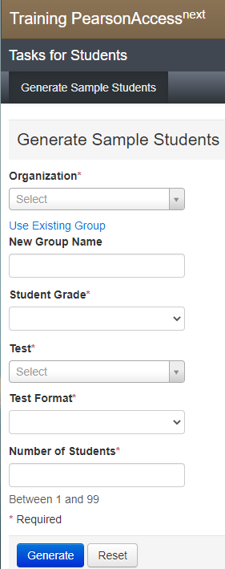
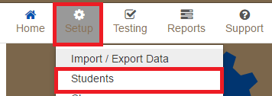
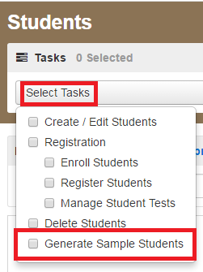
PAN Setup – Create Sample Students
1.
3.
2.
Notes:
Create Sample Student Records and Groups: For the purpose of the Infrastructure Trial, it is recommended that you generate sample student records for the number of students who will be participating in the trial. Note that the Department does not recommend using live student data for the Infrastructure Trial. DESE can provide sample student data for schools upon request – please email mcas@doe.mass.edu.
To create sample student records in PearsonAccess Next:
Go to Setup and select Students.
Then go to Select Tasks and Generate Sample Students, then click Start.
On the “Generate Sample Students” page, select the Organization, and then click Create a New Group and fill out the New Group Name. A Group is simply a grouping of sample students that can easily be pulled into a Session. Create a descriptive group name (e.g., “Grade3ELA") that will be easy to identify when you create Sessions in PAN.
Fill out the remainder of the fields on the “Generate Sample Students” page with the following considerations:
Create sample student records in the grades and subject areas to be tested.
Create at least as many students who will be concurrently testing on any given day, in order to approximate the maximum load on the network.
Set the Test Format to Online.
When finished, click Generate, and then click Exit Tasks.

Slide 16
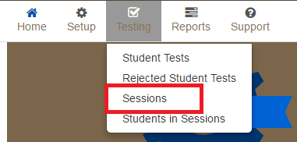
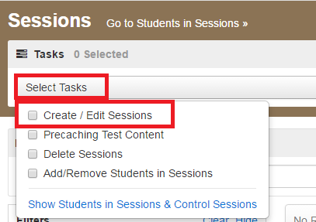
PAN Setup – Create Sessions
1.
2.
Notes:
Create Sessions via User Interface: Once the sample students and groups are created, it’s time to pull those groups into Sessions.
Go to Testing, and then Sessions.
Click Select Tasks and Create/Edit Sessions, and then click Start.

Slide 17
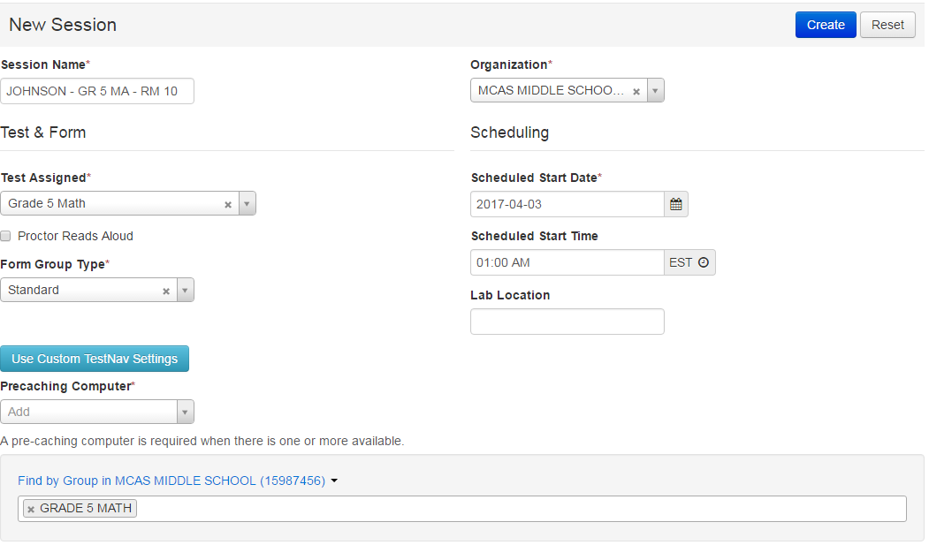
PAN Setup – Create Sessions
Notes:
Fill out all the required fields at the top of the screen. Note the following:
It is a good idea to choose a naming convention for the Sessions in PAN that's easy for your test administrators to find and manage. You could use the administrator name, room number of the testing location, grade, subject, or any combination of these. A Session can only be populated with students who are assigned the same test code (i.e., taking the same grade and subject area test).
The Form Group Type will default to Standard, unless the Proctor Read Aloud box is checked, in which case you must select the Human Read Aloud or Human Signer Form Group Type.
If your technology coordinator has set up ProctorCache, you must choose your precaching computer here. You may do this step later if needed and if not yet configured.
When you get to the bottom of the screen where it says Add students to session, change the drop-down to Find by Group. When you click in the text box, the groups of students that are assigned to the same test as your Sessions will appear. You may add one or all groups that populate to this Session. Click Create. Then, click Exit Tasks.

Slide 18
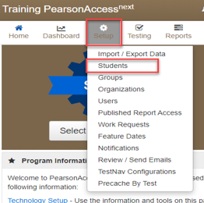
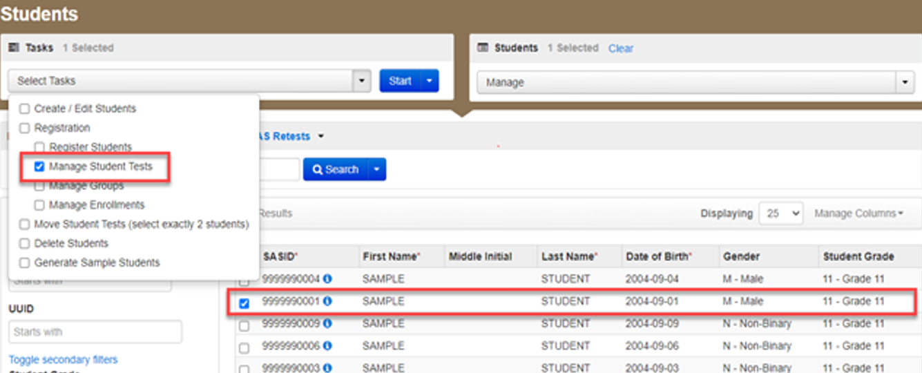
PAN Setup – Edit Student Records
Notes:
Edit Student Records: For the Infrastructure Trial, you may need to edit student records to add or remove accommodations for a student.
Follow these steps to edit students within the PAN user interface:
From Setup, select Students.
Select the student whose test will be assigned an accommodation and select Manage Student Tests from the “Select Tasks” drop-down menu. Then click Start.

Slide 19
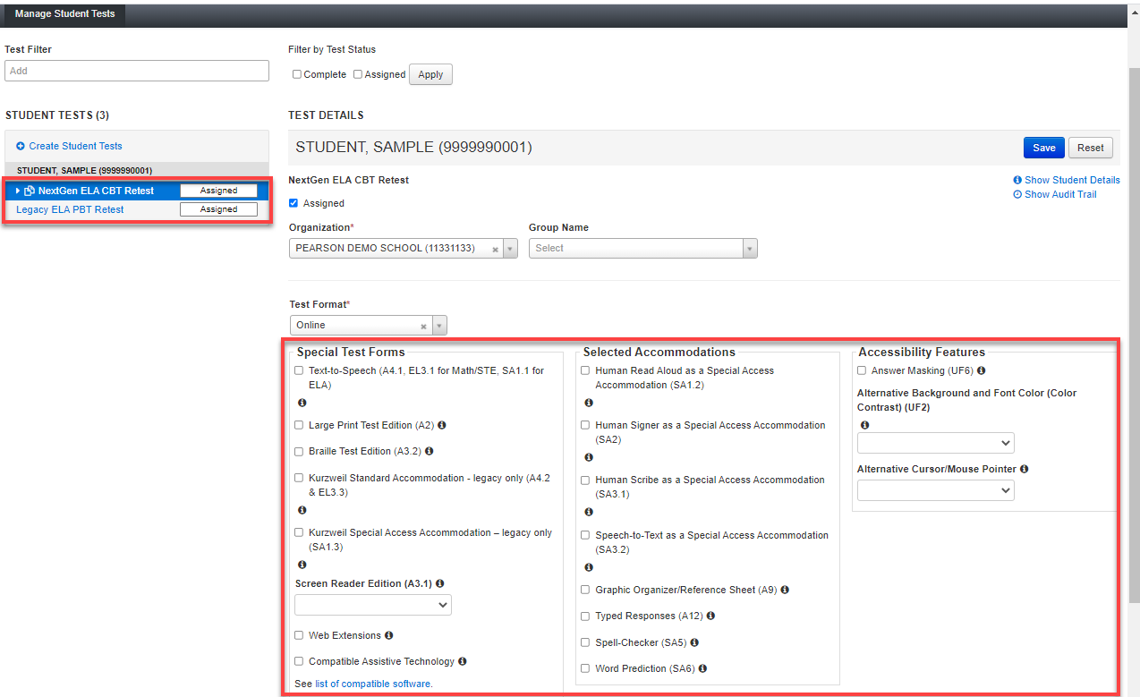
PAN Setup – Edit Student Records (cont’d)
Notes:
3. Select the subject area test on the left-hand side of the screen, and select the appropriate accessibility features and/or accommodations.

Slide 20
PAN Setup – Edit Student Records (cont’d)
Notes:
4. Recommended: Revise the sample student name so that the accommodated test is easier to find. Select the Add Task button on the top black bar, and then select Create/Edit Student and select the student record on the left to update the name. After updating the name, click Save.

Slide 21
PAN Setup – Form-Dependent Accommodations
The following form-dependent accommodations are important to verify before testing because they cannot be changed after a student signs in to the test.
Text-to-speech
ASL video edition of the grade 10 Mathematics test and June high school Science tests
Spanish/English edition of the grade 10 Mathematics test/retest and high school Science tests
Screen reader edition
Compatible assistive technology
DESE recommends practicing with these accommodations during the Infrastructure Trial to confirm that the school is ready to administer the accommodations during operational testing.

Slide 22
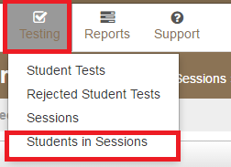
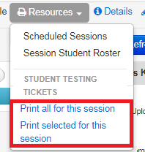
PAN Setup – Print Student Testing Tickets
Notes:
Print Student Testing Tickets: Testing tickets are needed for students to log in to TestNav.
1. Go to Testing then Students in Sessions. 2. Click the Add a Session button on the left-hand side of the screen and search for your PAN Session, or use one of the available filters at the top of the dialog box. Click on your PAN Session name on the left-hand side of the screen.
3. Click Resources.
4. Under Student Testing Tickets, select either Print all for this session or Print selected for this session. There are options to print one per page, four per page, a grid, or a list. Students will use the Username and Password on the tickets to log in to TestNav on their devices. You can also find the Proctor Testing Tickets in this menu if your students are in a Human Read-Aloud or Human Signer Session. No responses should be entered into the test using the Proctor Testing Ticket, as they will not be saved. Students must log in using their own student testing ticket.
5. Confirm Student Test Forms: On the “Students in Sessions” screen, you should be able to see any special test forms that are assigned by an indicator next to the students’ name. This will include Text-to-Speech (TTS), Screen Reader (SR), and Assistive Technology (AT). If you do not see the indicators as expected, you can still update the student record in the Manage Student Tests task. An Assistive Technology form is available for grade 3 ELA and a Screen Reader form is available for grade 3 Math and can be used to test the assistive technology or screen reader with the student device running TestNav. Consult the Guidelines for Using Assistive Technology for more information (https://www.doe.mass.edu/mcas/accessibility/default.html)

Slide 23
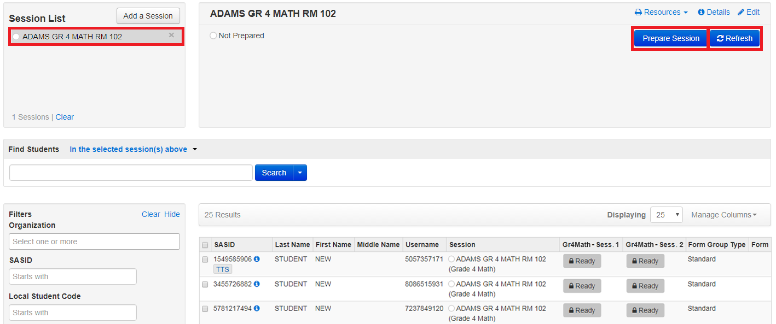
PAN Setup – Prepare sessions
Notes:
Session Management:
Prepare: Before students can log in, the PAN Session must be prepared by a test coordinator or test administrator. Preparing a PAN Session will assign the proper test forms to the students. You can prepare a PAN Session in two ways:
To prepare a single PAN Session: Go to Testing > Students in Sessions, select a Session from the Session List and click Prepare Session.
To prepare multiple PAN Sessions: Go to Testing > Students in Sessions, use Combined View to select multiple sessions. Click Prepare All Sessions.
After you click Prepare, click the blue Refresh button until you see the green Start Session button, which is shown on the next slide.

Slide 24
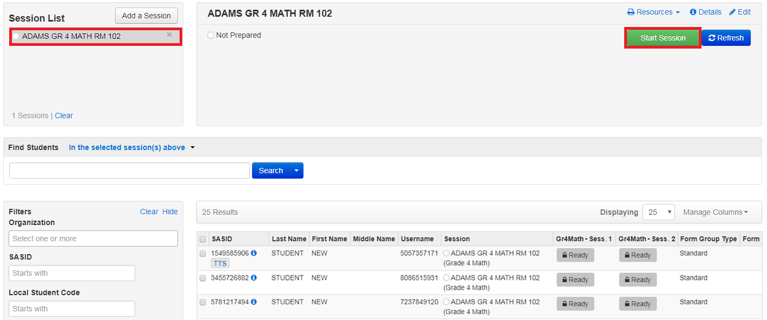
PAN Setup - Start Session
Notes:
Now that the Sessions have been prepared, you may start the Session. To start a Session from the Students in Sessions page:
1. Click the Session name from the Sessions List. The Session Details screen will appear for the Session selected. If multiple Sessions are selected, the option to Combine View appears.
2. Click the green Start button in the Session Details screen. If multiple Sessions are selected and are combined, there is an option to start all Sessions.
3. Once the Session has started, the start button will change to a Stop Session button which will allow you to stop the Session after all students are in Completed or Marked Complete status. Stopping Sessions will be explained in an upcoming slide.

Slide 25
During and After Testing - Unlock Test
Unlock for all students:
Unlock for single student:
Notes:
Before students can begin testing, their tests must be unlocked. Typically, you will unlock the whole test session for a class of students who will be testing. If you have students taking a make-up test, it is suggested to only unlock the tests for the individual students who will be testing. You can unlock all student tests in a testing session by selecting the unlock button next to the desired session. You can unlock individual student tests by selecting the icon next to each student's Ready status.

Slide 26
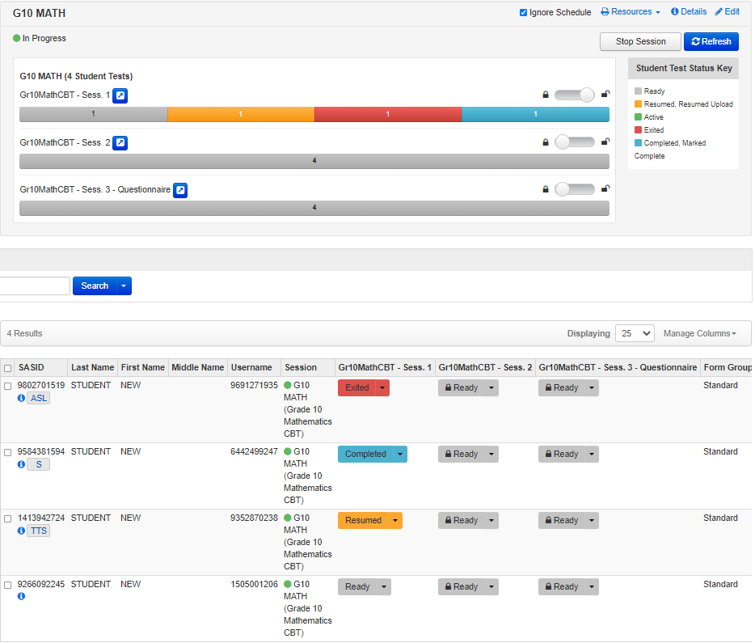
During and After Testing - Monitor Progress
Notes:
Once students log in to TestNav using their testing ticket, you can monitor their progress. The Student Test Status will change for each student individually. The test status for each student is displayed in the Session window.
Status Descriptions
Ready: The student has not signed in to the session yet, but is ready to sign in.
Active: The student is currently signed in to the test.
Exited: The student has exited the test session but has not submitted their responses yet (after a test session, after signing out to take a break, or if an error occurs). Students in Exited status will need to be resumed by a test administrator when they are ready to reenter the test. If a student signs out of a test session or if the testing device loses connectivity before the test is completed (or marked complete), the test will appear in Exited status. The test administrator will then need to resume the student’s test (and the student will then appear as Resumed).
Completed: The student has completed the test session and has successfully submitted their responses.
Marked Complete: The student’s test session has been marked complete by the principal/designee (the student did not submit the test in TestNav).
Resumed: The student is ready to sign back in to the test session. This status appears after a student has exited TestNav while the session is ongoing, and the test administrator has “Resumed” the student in PAN.
Resumed-Upload: The student is ready to sign back in to the test session, but some responses may not have been sent to the testing subcontractor’s (Pearson’s) servers before the student exited the test. When the student signs in to a test with a Resumed–Upload status, a staff member must be present. TestNav may prompt the user to locate the saved responses from the designated save location and upload them to TestNav before the student’s test can be resumed. If the student is resuming on the same device as their last attempt, they should select the Skip Upload button on the TestNav screen.
The number of test sessions varies by content/grade:
ELA (all grades): There are two test sessions - however, only the first session contains test content.
Math (grades 3 and 5-8): There are two test sessions.
Math (grades 4 and 10): There are three sessions – however, only the first two sessions contain test content.
Science (grades 5 and 8): There are three test sessions - however, only the first session contains test content.
Biology and Introductory Physics: There are two test sessions - however, only the first session contains test content.
A stop sign will appear in the second session encouraging students to exit TestNav.

Slide 27
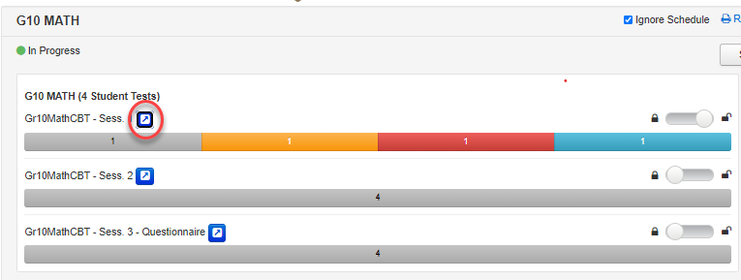
During and After Testing - Monitor Progress
Notes:
Test Administrators and Test Coordinators can also monitor student progress in a test session by selecting Monitor Test Progress on the Students in Sessions screen. When this is selected, PAN users can view detailed test information for each student in the session including the number of questions answered and the number of questions remaining, as well as the duration of time in the test.

Slide 28
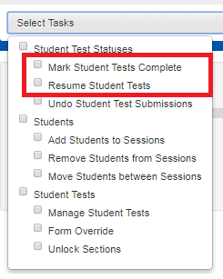
During and After Testing - Mark Test Complete / Resume Test
1.
2.
Notes:
Student tests are marked complete when a student has not finished testing in the usual manner and is not going to return to the test. For more information on this task, visit this page on the PAN Support Site: https://support.assessment.pearson.com/PAsup/testing/mark-student-tests-complete
Note that only test coordinators (and not test administrators) can mark tests as complete.
Student tests need to be resumed if the student leaves the test for any reason before completion. When the student leaves the test, it moves into exited status. Before the student returns to testing, the Test Administrator will follow the steps below to place the test into resumed status. The student can then log in to the test and proceed with testing.
To mark a test complete or resume student tests:
1. Go to Testing.
2. Click on Students in Sessions.
3. Be sure the PAN Session name is selected on the Session List.
4. At the bottom of the screen, check the box next to the student name(s) whose status you would like to change.
5. Go to Select Tasks and select from the menu the action you would like to complete.

Slide 29
TestNav Tools Demonstration
Notes:
There are a number of tools that are available in TestNav. Students should be encouraged to try all the tools available to them while participating in the Infrastructure Trial.
Please select the play button above to view the demonstration.
Highlighter: Click and drag over text on the screen, then choose a color. Highlight the text again and choose the option with the red slash to remove the highlighter. There are four highlighter colors available – pink, blue, green, and orange.
Line Reader: At the top of the screen, click the User drop-down menu. Choose the Show Line Reader Mask option to turn the Line Reader on. There are multiple places in the line reader tool where it can be adjusted. Choose Hide Line Reader Mask to hide the tool.
Bookmark: At the top of the screen, click the Bookmark button to bookmark the test question for later.
Review: Click the Review button at the top of the screen to show all test questions that were answered, not answered, and bookmarked. You can skip to any test question directly from this menu.
Answer Eliminator: At the top of the screen, click the Answer Eliminator button, which looks like an X. On multiple-choice or multiple-select test questions, this tool may be used to mark an “X” on the options that the student thinks are incorrect.
Item Types: As students move through the practice test, encourage them to practice with all of the different item types and ask questions.
New for 2023-24: All students now have access to the Color Contrast and Answer Masking accessibility features in TestNav. To access these, select each accessibility feature in the User drop-down menu.

Slide 30
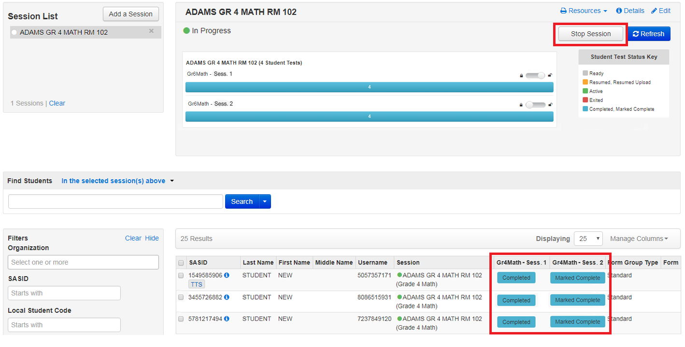
During and After Testing - Sign out of TestNav Stop Sessions
Notes:
Sign Out of TestNav:
For all the Infrastructure Trial tests, when students finish testing, they should click on the green “Submit Final Answers” button, and then sign out of TestNav.
Stop Sessions:
After testing during an operational administration, test administrators and test coordinators will need to stop PAN Sessions, but this is not needed for the Infrastructure Trial. However, test administrators and test coordinators may want to try this out during the Infrastructure Trial; they can do so once all students’ sessions are in “Complete” or “Marked Complete” status. In order to stop sessions, select the ”Stop Session” button.
After the Infrastructure Trial, it is advised to set aside some time with technology coordinators, test coordinators, and test administrators to discuss how the trial worked and if there could be improvements made prior to operational testing.

Slide 31
Resources
TestNav and ProctorCache requirements and download links
MCAS Infrastructure Trial Readiness Guide
PearsonAccess^{next} Training Site
PearsonAccess^{next} User Guide
Student Tutorial
MCAS Test Administration Resources
Guidelines for Using Assistive Technology
Notes:
Here are the resources to help you with the Infrastructure Trial.

Slide 32
Thank you.

